Slide 1

Prediction of Airline Ticket Fares Using ML Algorithms
By Amaan Aslam Ashraf

Slide 2
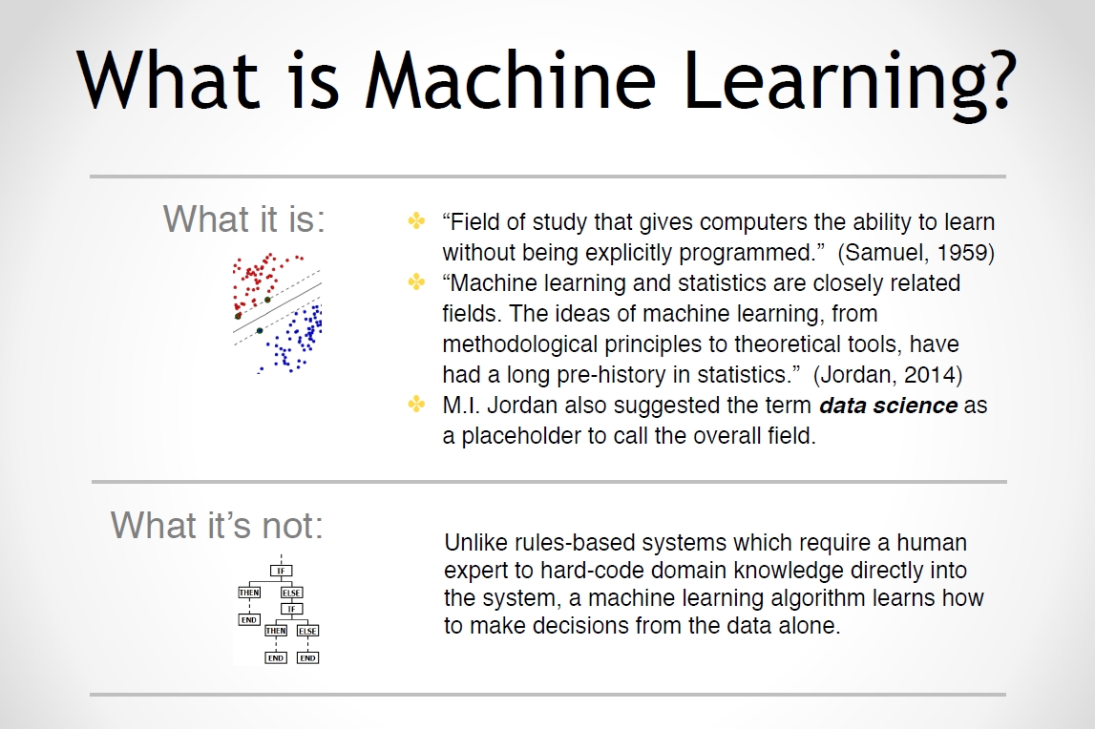

Slide 3
Statement of the problem
Flight ticket prices can be something hard to guess, today we might see a price, check out the price of the same flight tomorrow, it will be a different story.
We might have often heard travelers saying that flight ticket prices are so unpredictable.
The objective of the project is to automate the predictions of Airline ticket fare with the help of machine learning algorithms.
In this project, we will go through the entire life cycle of a Data Science project.

Slide 4
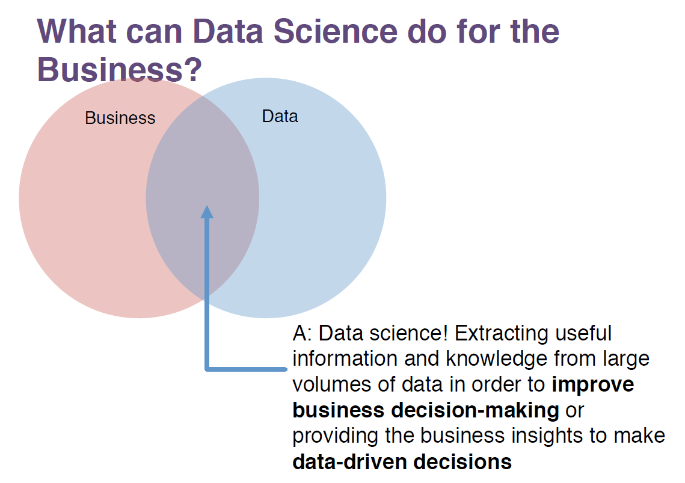

Slide 5
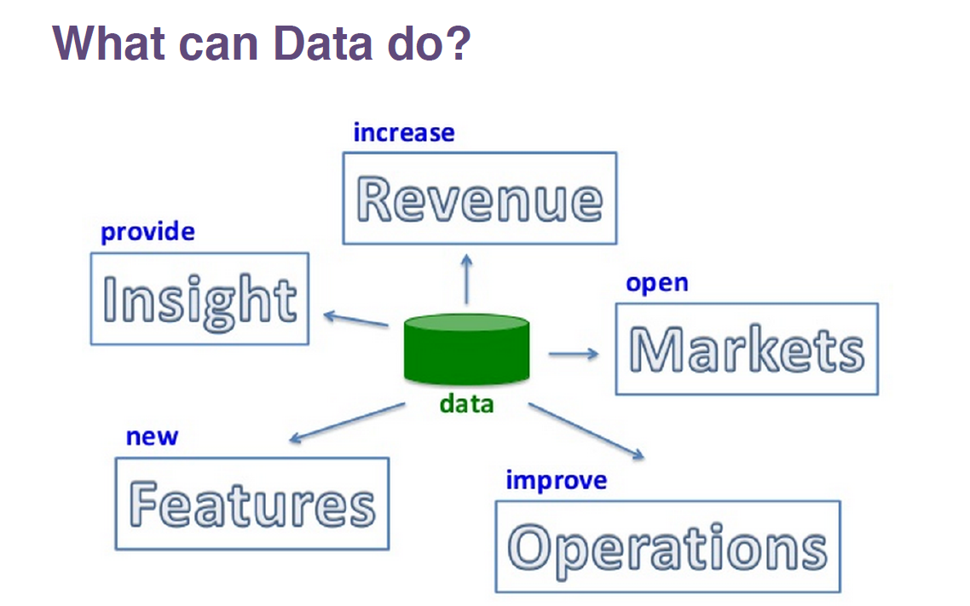

Slide 6
The art & science of data science
Discover unknowns in data
Obtain predictive and actionable insights
Communicate business data stories
Build confidence in decision making
Create valuable data products that has business impacts

Slide 7
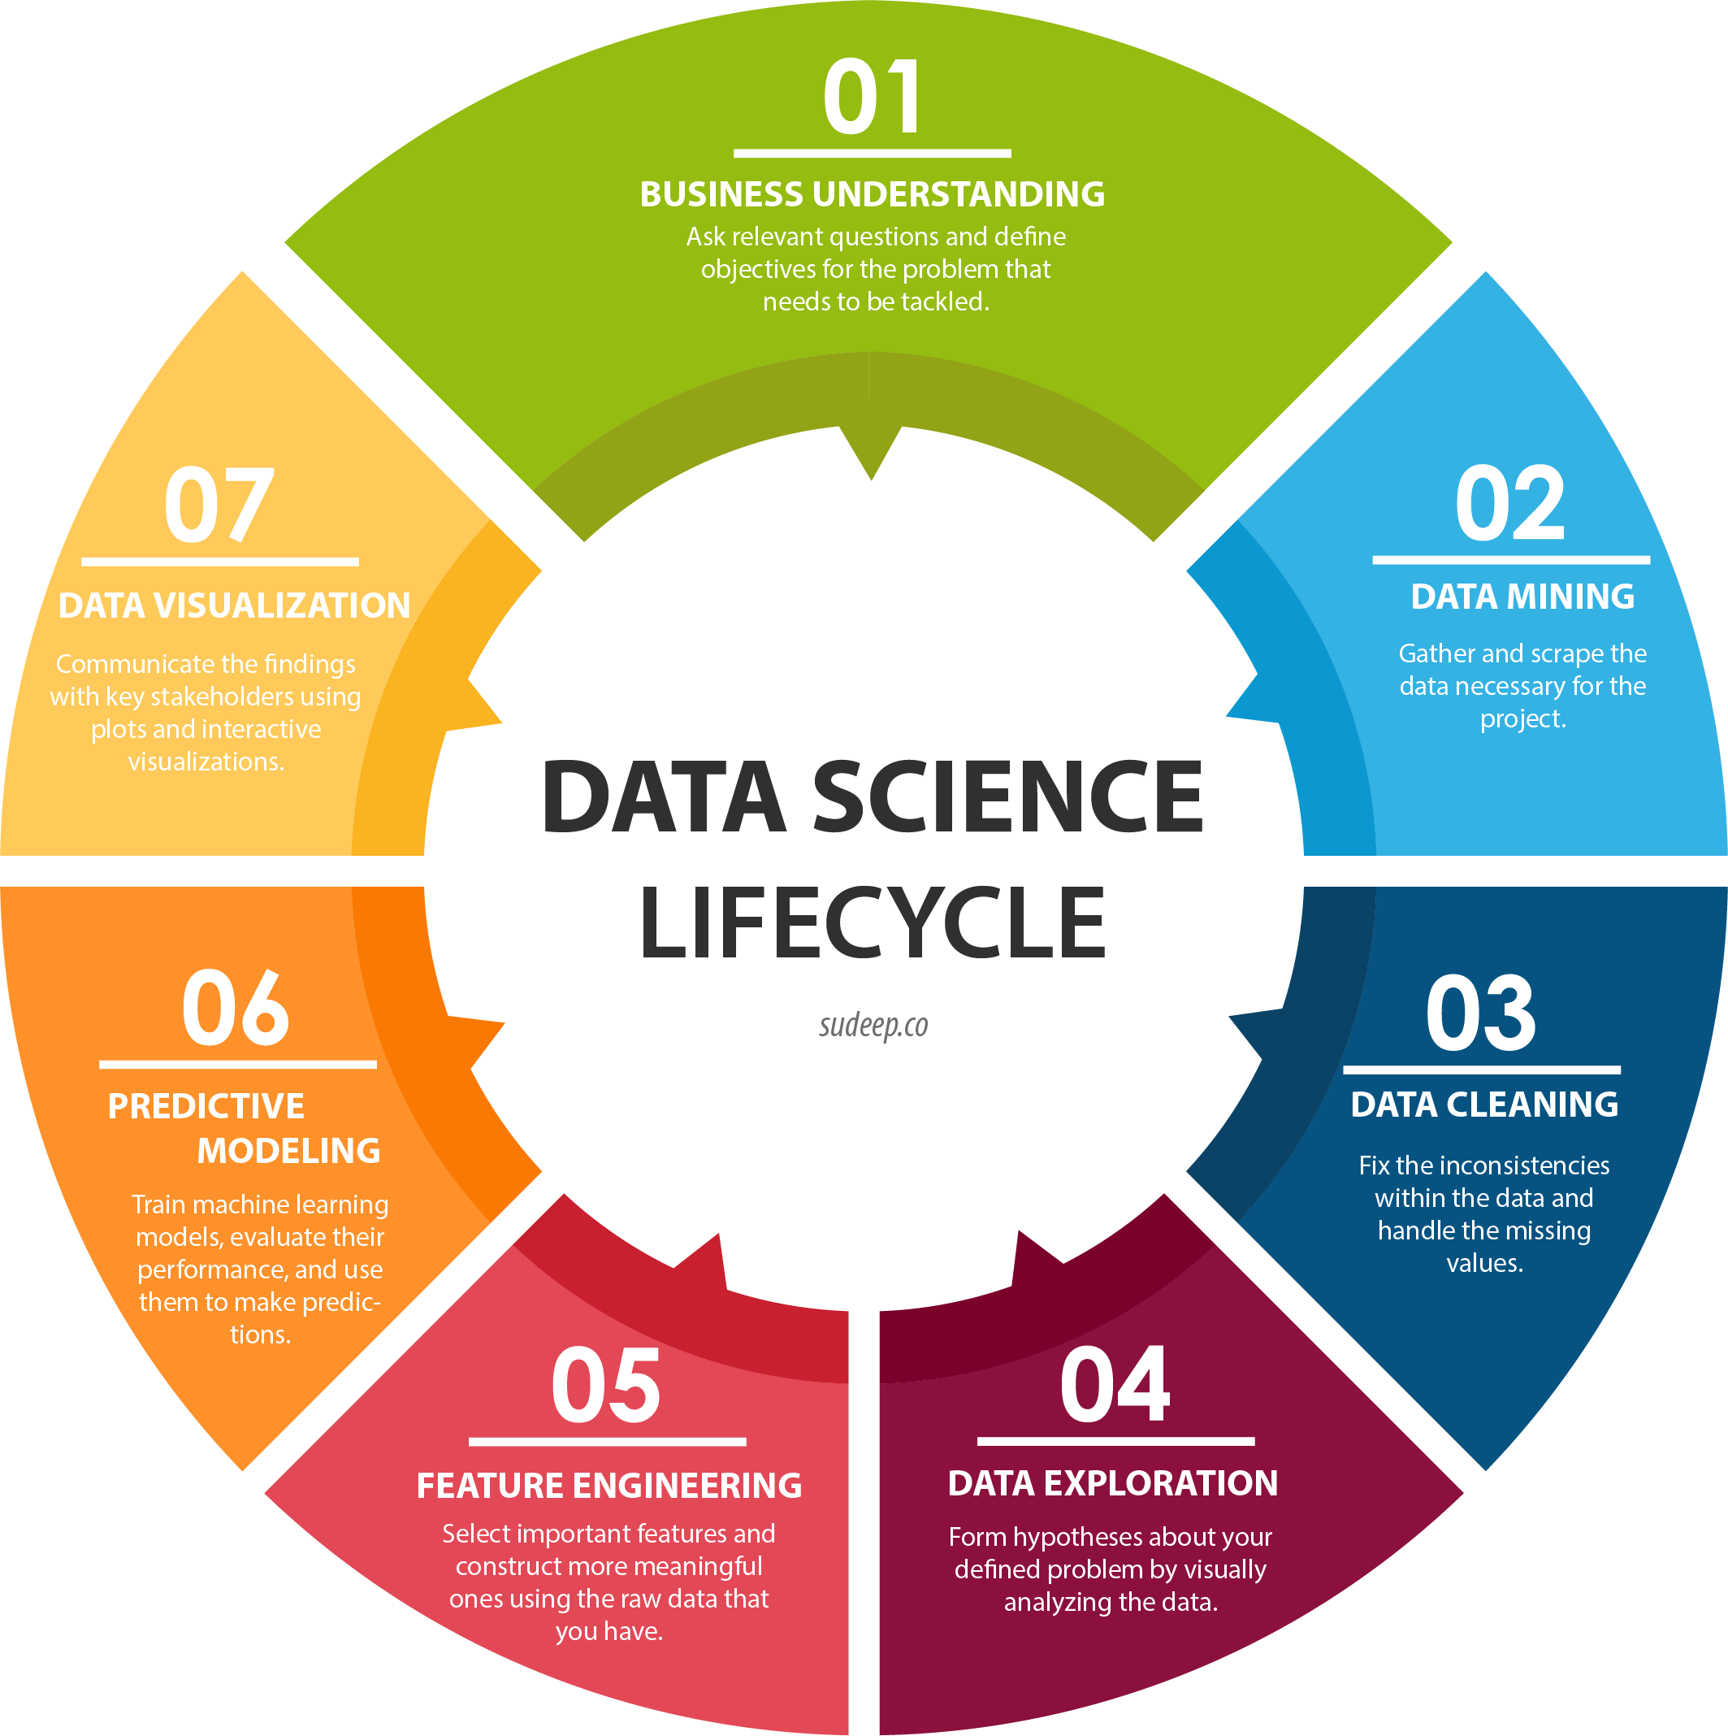
Life cycle of data science project

Slide 8
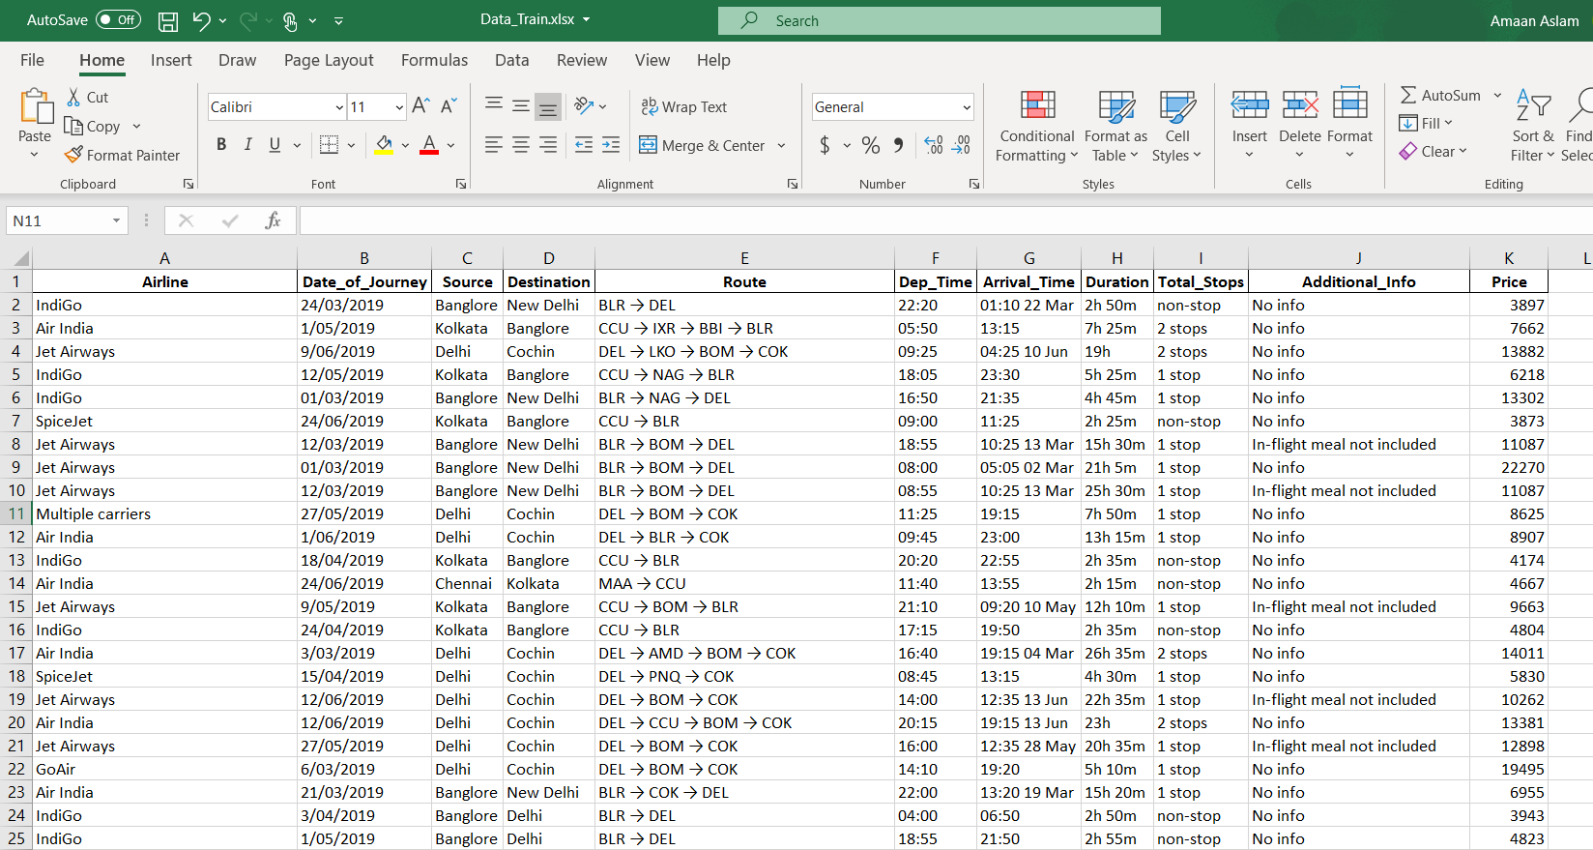
Understanding the dataset

Slide 9
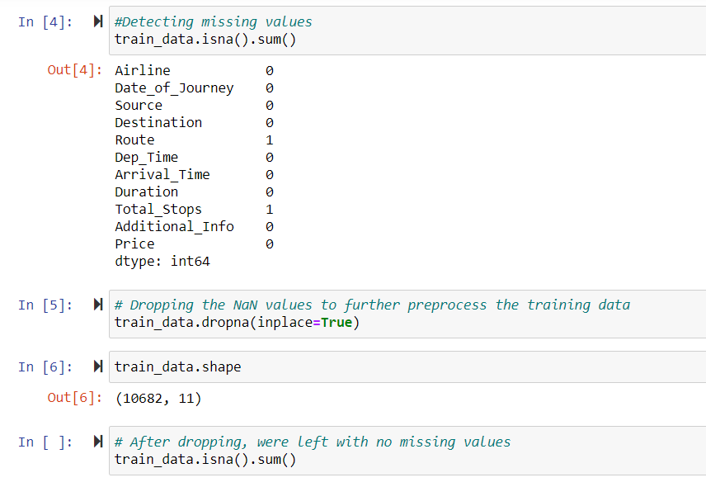
Data cleaning

Slide 10
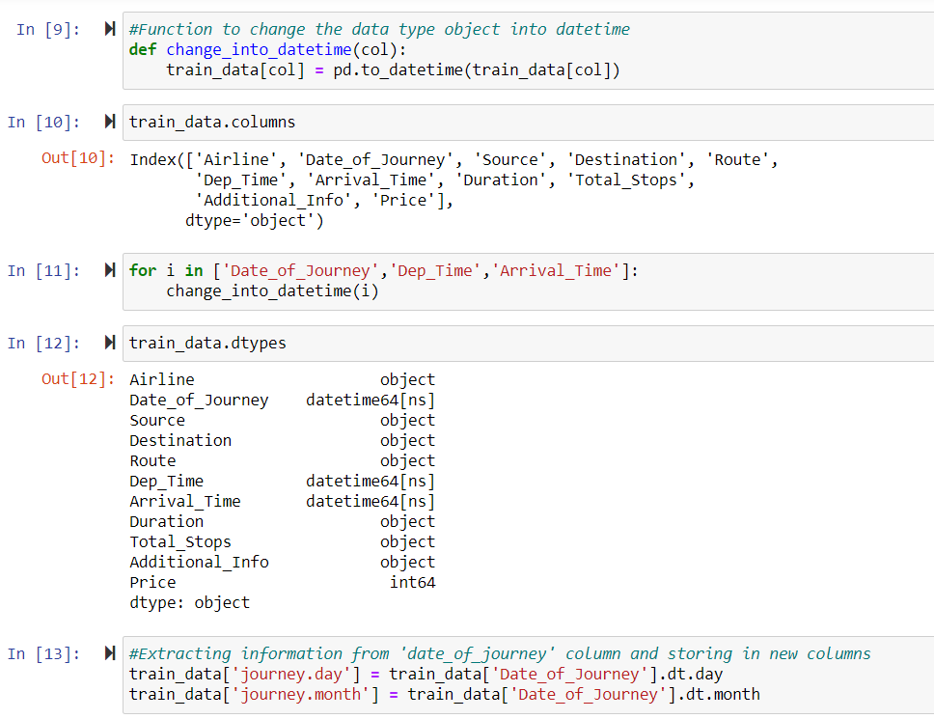
Data preprocessing

Slide 11
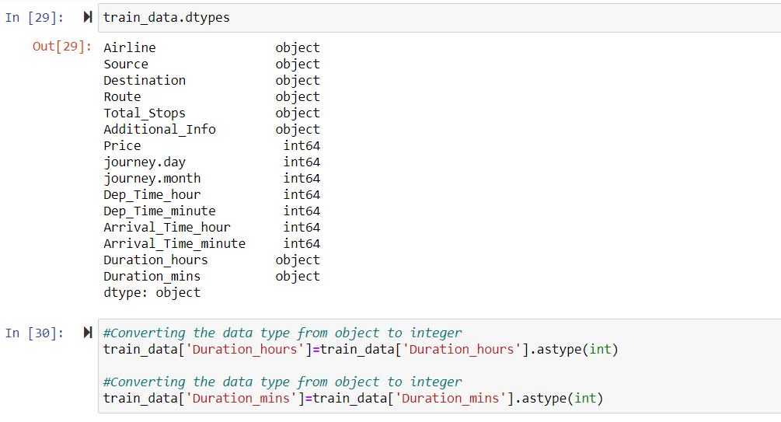
Feature engineering

Slide 12
Handling categorical data
One Hot Encoder: Used for Nominal Data
Label Encoder: Used for Ordinal Data

Slide 13
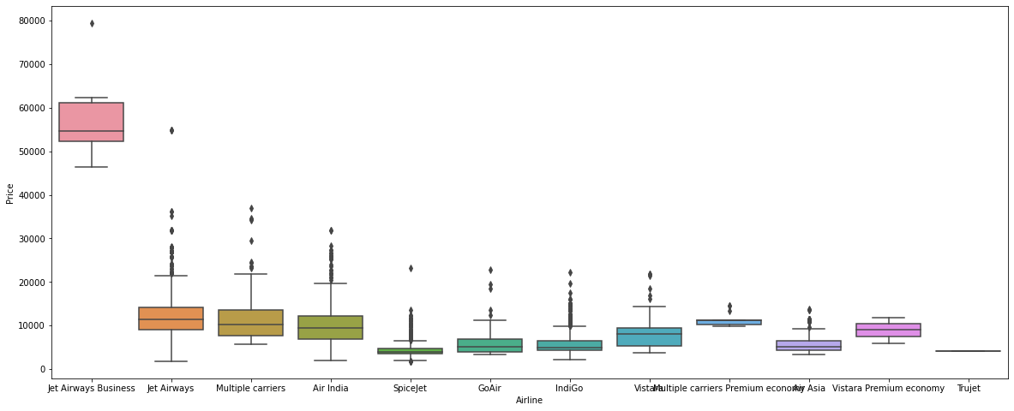
Data visualization

Slide 14
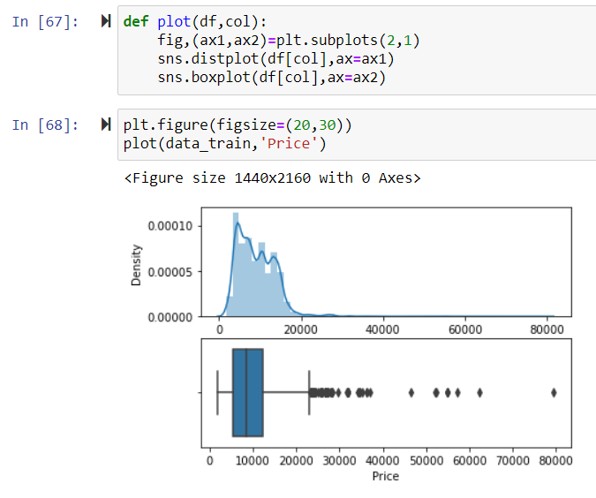
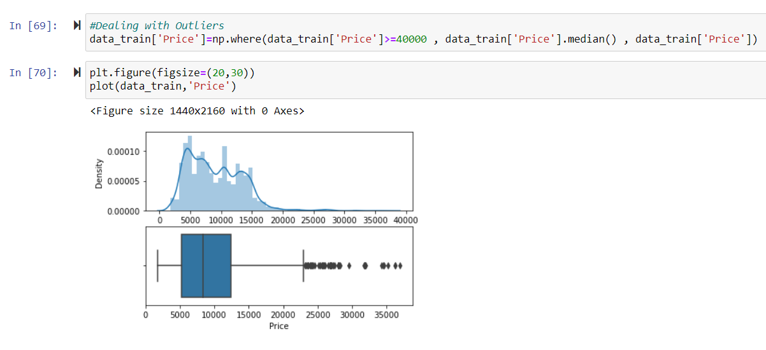
Outlier detection

Slide 15
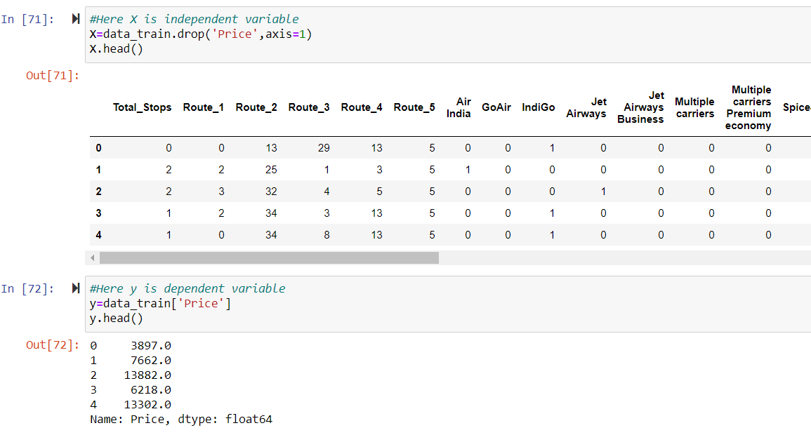
Separating independent & dependent data

Slide 16
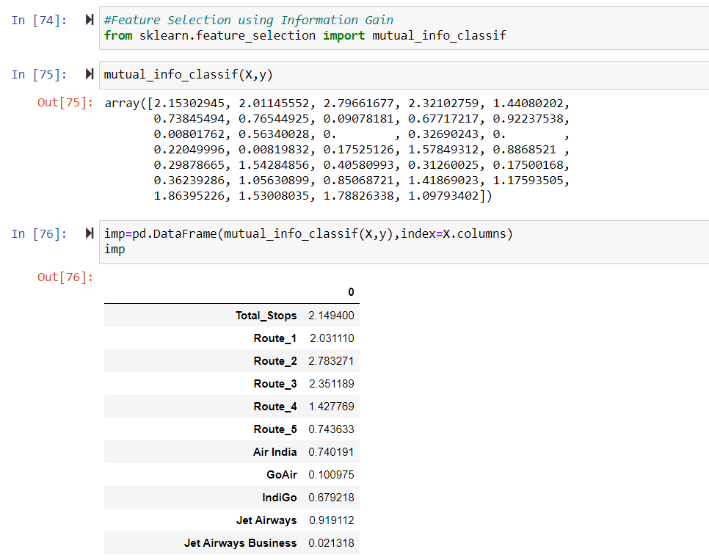
Feature selection

Slide 17
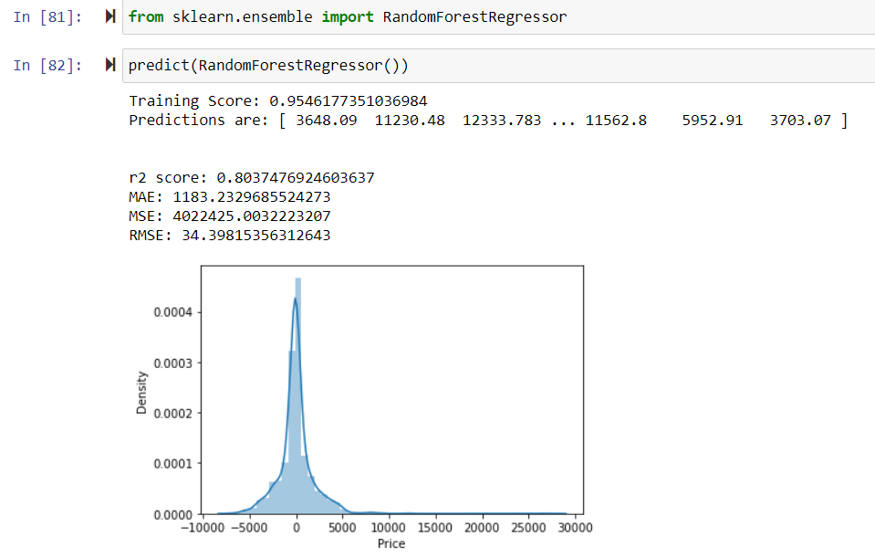
Random Forest

Slide 18
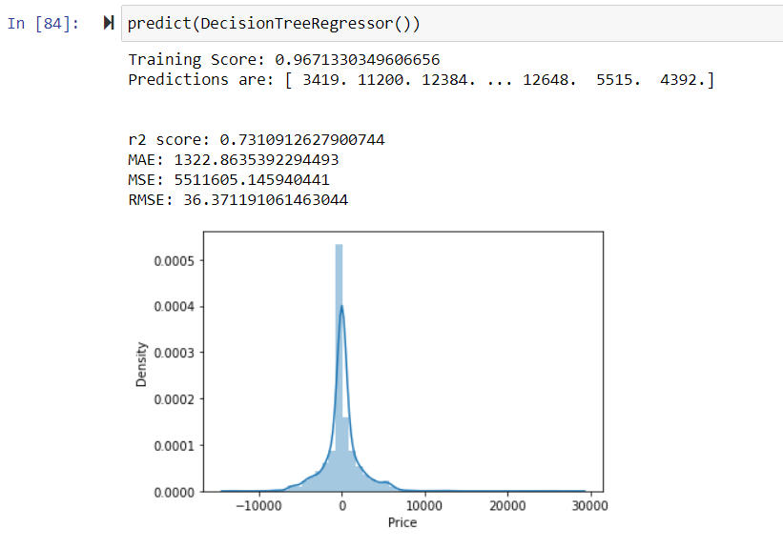
Decision Trees

Slide 19
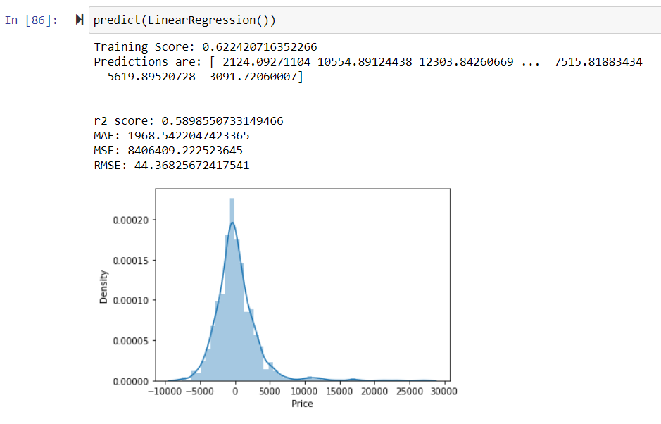
Linear regression

Slide 20
Hyperparameter tuning
Randomized Search CV
Grid Search CV

Slide 21
K-fold cross validation
Shuffle the dataset randomly.
Split the dataset into k groups
For each unique group:
Take the group as a hold out or test data set
Take the remaining groups as a training data set
Fit a model on the training set and evaluate it on the test set
Retain the evaluation score and discard the model
Summarize the skill of the model using the sample of model evaluation scores

Slide 22
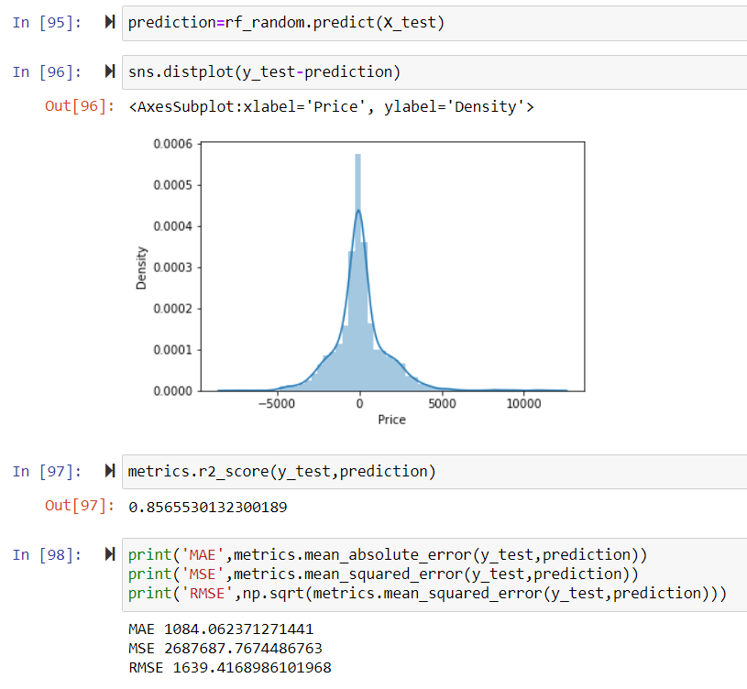
Final output
Almost 85% accuracy

Slide 23

Questions?

